Slide 1
L T M : Local Travel Mate
20152775 Abdullaev Farkhodjon
20152776 Erkinov Habibilloh
20131658 김남우

Slide 2
00.
Index
Main Page
-Mock-up Screenshot
-Use case Diagram
-Use case Scenario
Use case Diagram
-Mock-up Screenshot
-Use case Diagram
-Use case Scenario
Use case Scenario
-Mock-up Screenshot
-Use case Diagram
-Use case Scenario

Slide 3
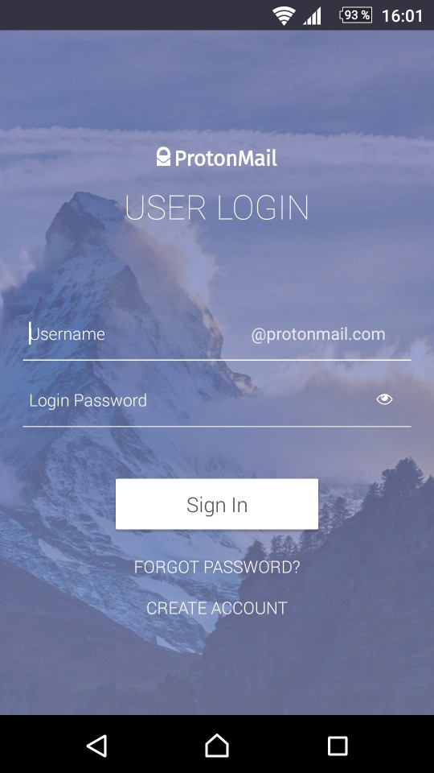
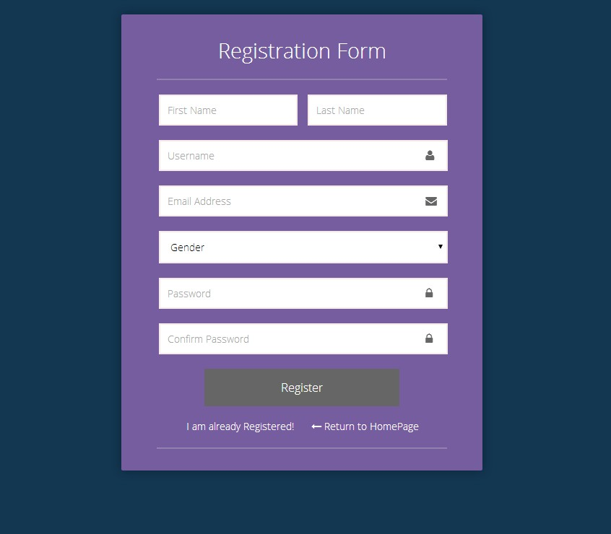

01.
Main Page
Mock-up Screenshot
Use case Diagram
Use case Scenario

Slide 4
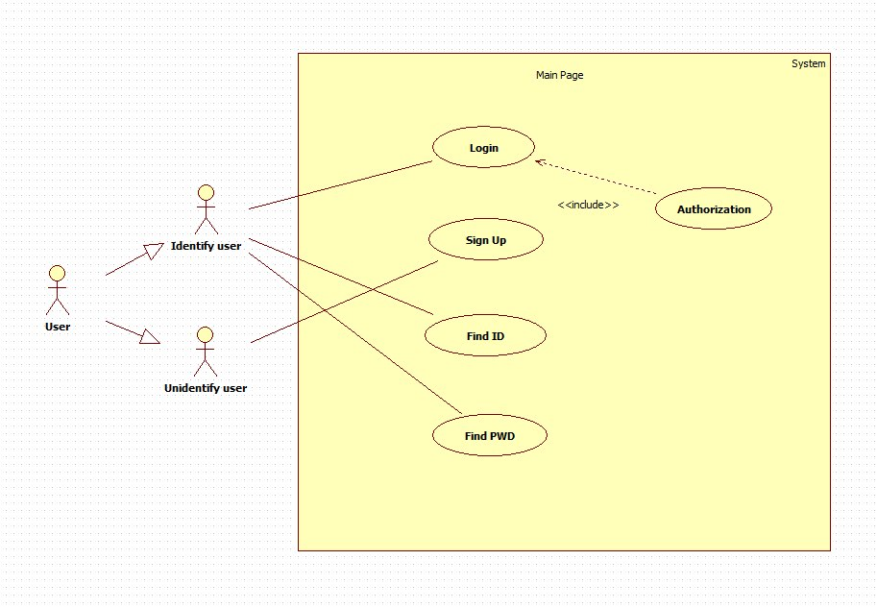
01.
Use case Diagram

Slide 5
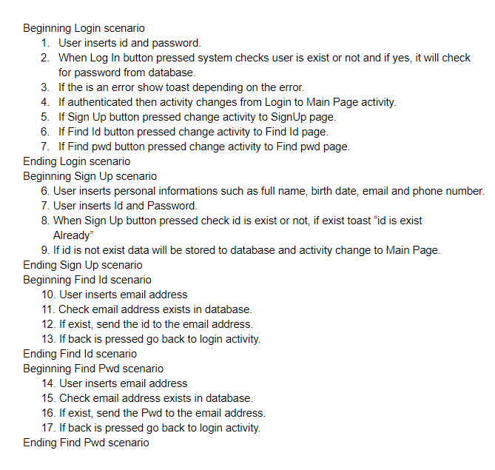
01.
Use case Scenario

Slide 6
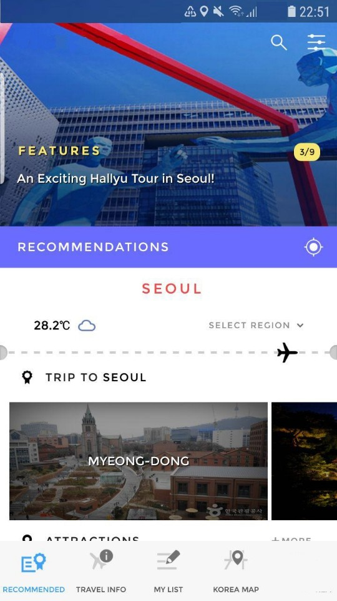
02.
Select Country
Mock-up Screenshot
Use case Diagram
Use case Scenario

Slide 7
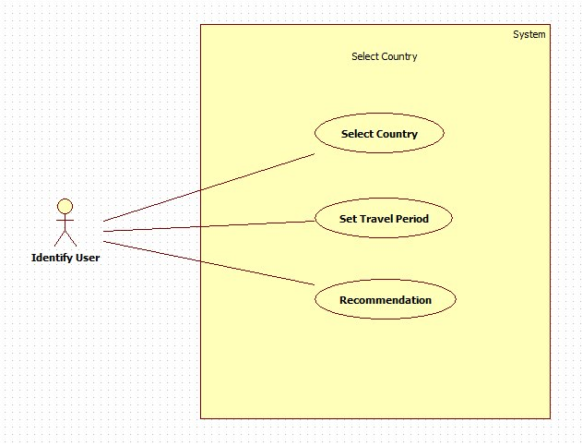
02.
Use case Diagram

Slide 8
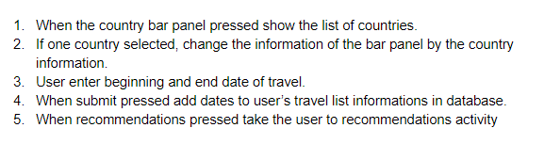
02.
Use case Scenario

Slide 9
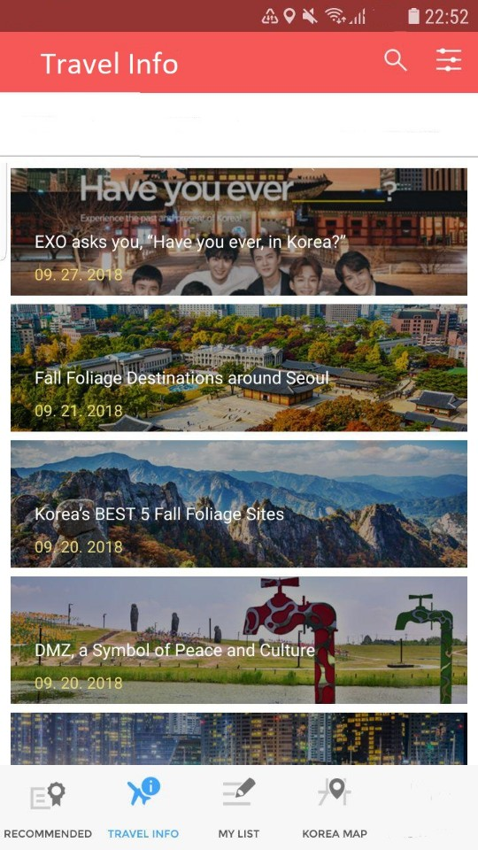
03.
Board Page
Mock-up Screenshot
Use case Diagram
Use case Scenario

Slide 10
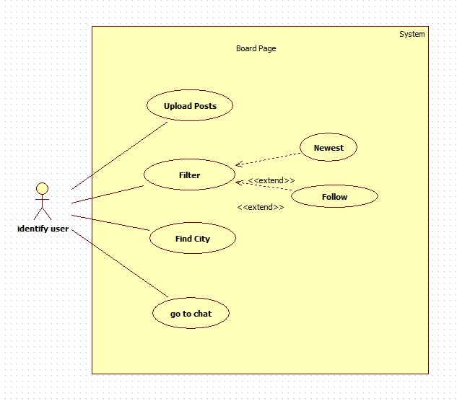
03.
Use case Diagram

Slide 11
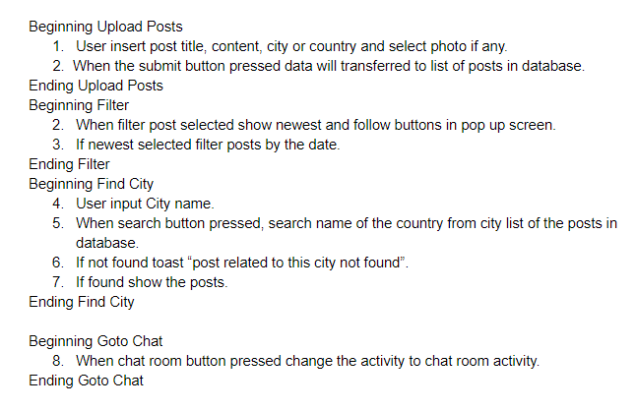
03.
Use case Scenario

Slide 12
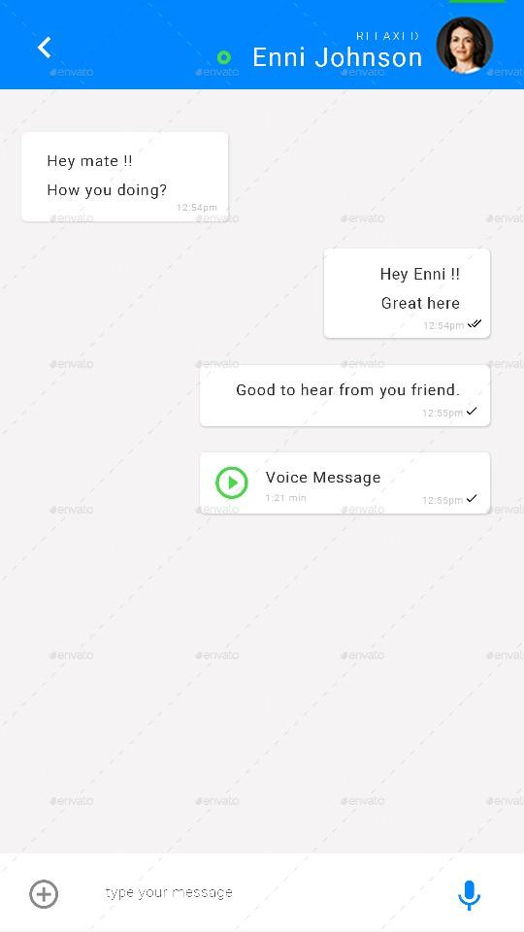
04.
Chat Page
Mock-up Screenshot
Use case Diagram
Use case Scenario

Slide 13
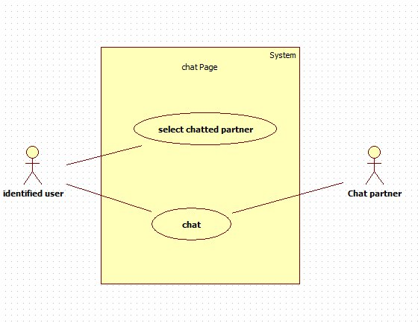
04.
Use case Diagram

Slide 14
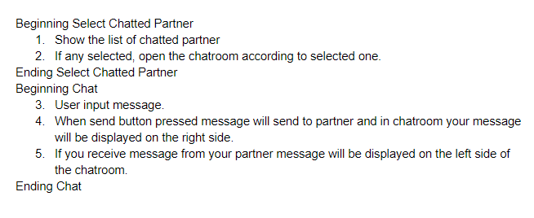
04.
Use case Scenario

Slide 15
THANK YOU
MADE IN YANG POWERPOINT FREE SHARE BLOG

